Slide 1
Introduction to Petrophysics with Python
Peter Kowalchuk
Online Course - October 2024

Slide 2
Thursday

Slide 3
Recap
More on Python classes
Lasio and Welly libraries
Operations with Dataframes
Importing different data file types: csv, las, witsml
Handling log data by columns

Slide 4
Managing Operations
Using Data Analytics
Was this well executed as expected?
Determine the amount of contact area to expect from a new wells
In a new contract, what are the geosteering expected metrics?
Is the well I drilling statistically the same as the field?
How to select one logging company from another

Slide 5
Managing Operations
Management tools
Metrics
What can be measured
KPI - Key Performance Indicators
Metric with operational limits
OKR - Objectives and Key Results
Objective: what we want to accomplish
Key Result: progress towards the objective
Initiative: what we will do to meet the objective

Slide 6
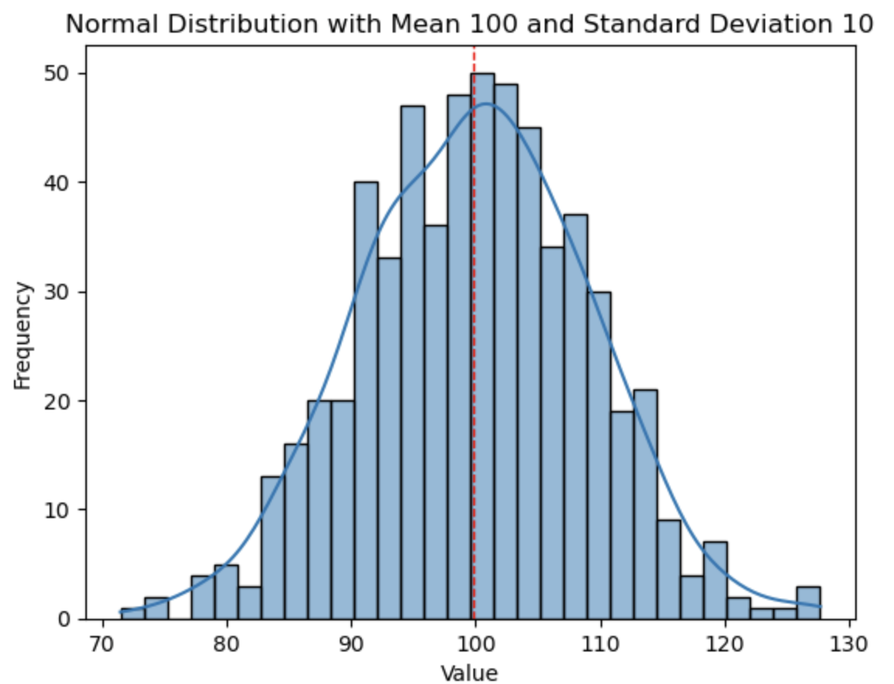
Metrics
Measuring operations
Defined by:
Mean
Standard Deviation
Examples:
Average ROP (m/hr)
Average NPT (%)
Days to Total Depth (m)
Total Footage per Well (m)
Well Tortuosity
Percent of Contact Footage (%)
Gamma ray in sand
Gamma ray in shale
Petrophysical values

Slide 7
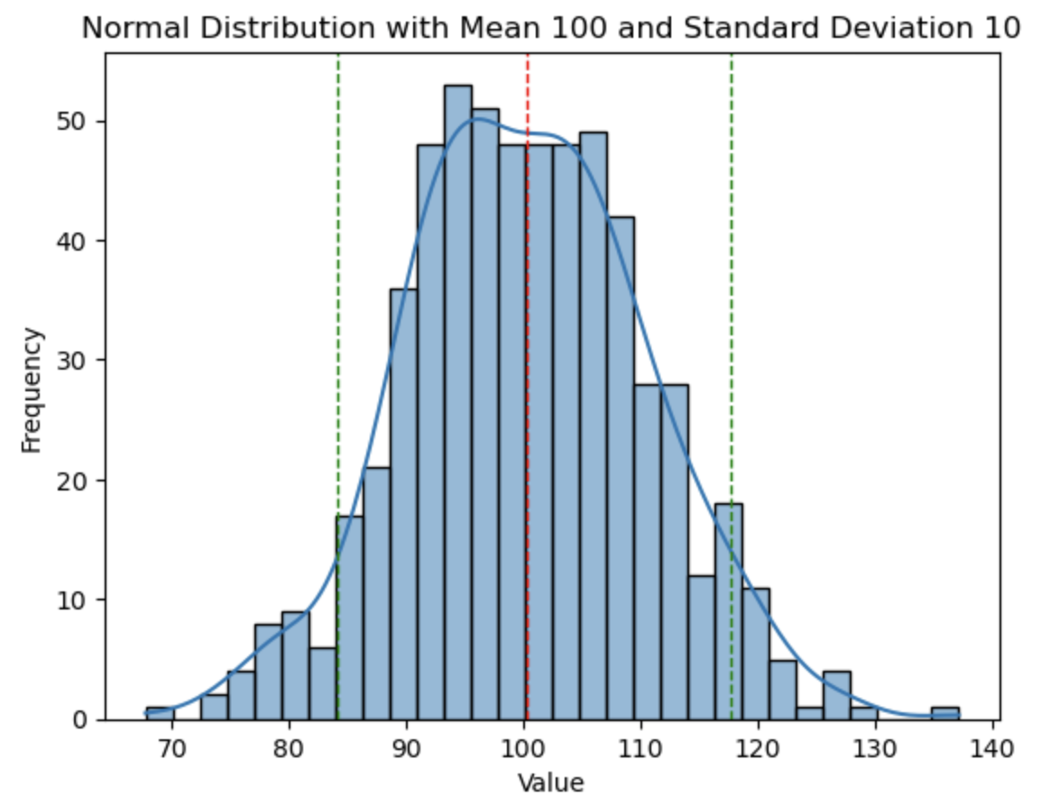
KPI - Key Performance Indicators
Defining operational results with limits
We add confidence intervals to the metrics
Confidence ranges tell us that the metric has a probability that its population is within that range with a probability X%
Typically X is 90%, 95% o 99% (in medicine)
This percentage represents the risk we are willing to take

Slide 8
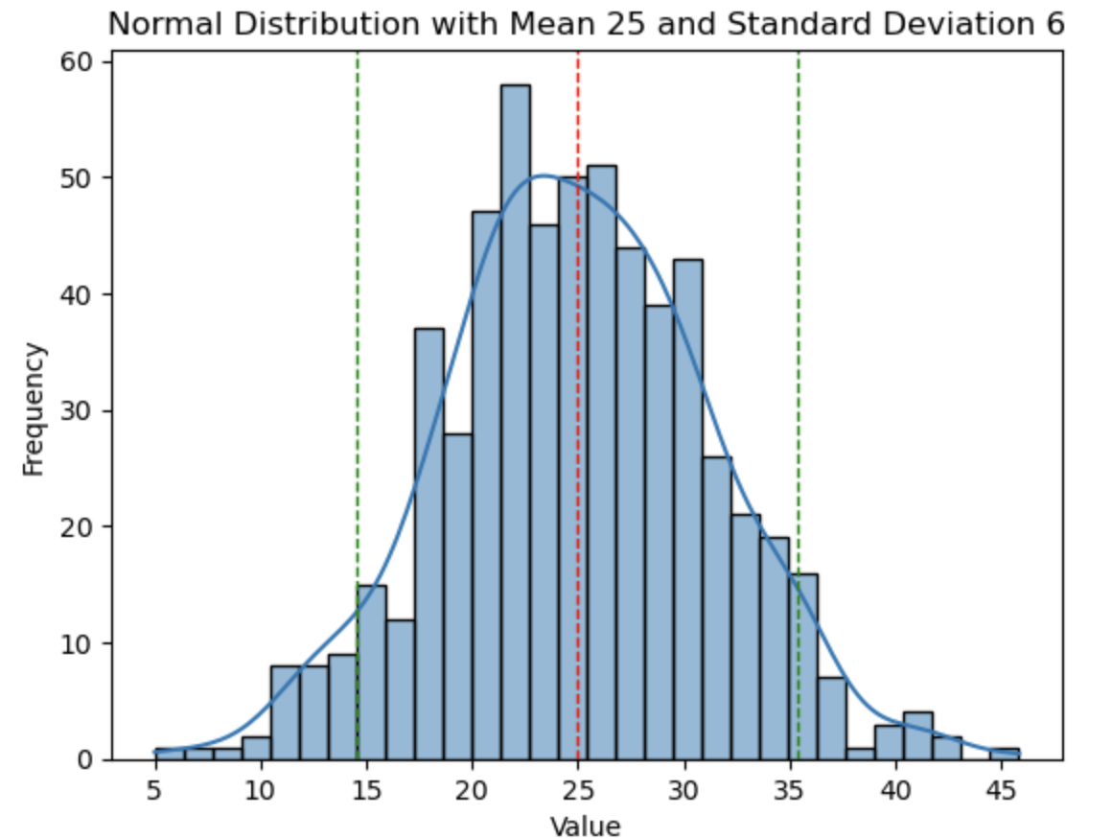
KPI - Key Performance Indicator
Example
After drilling 600 wells:
The average to complete a well is: 25 days
Standard deviation is: 6 days
With a confidence of 90%, how many days will it take to drill the next well?
It will take between 14.54 and 35.33 days

Slide 9
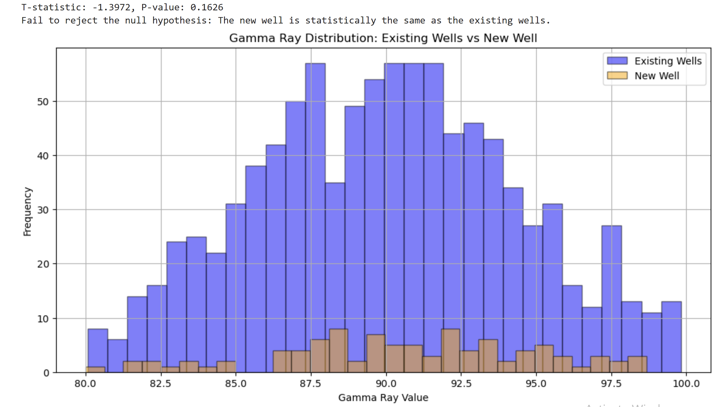
KPI - Key Performance Indicator
Example

Slide 10
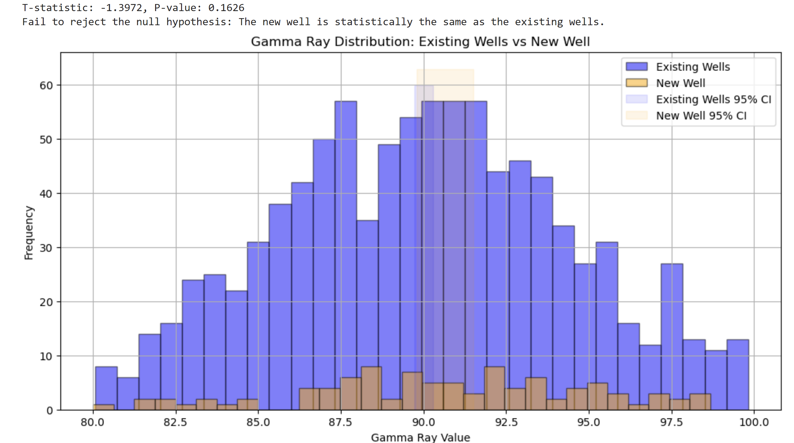
KPI - Key Performance Indicator
Example

Slide 11
Art of the possible
Analysis examples and new technologies
How are we using Data Analytics
New technologies
Unstructured data and NLP
Sentiment Analysis
Artificial Intelligence
AI Libraries
ChatGPT y LLM

